Slide 1
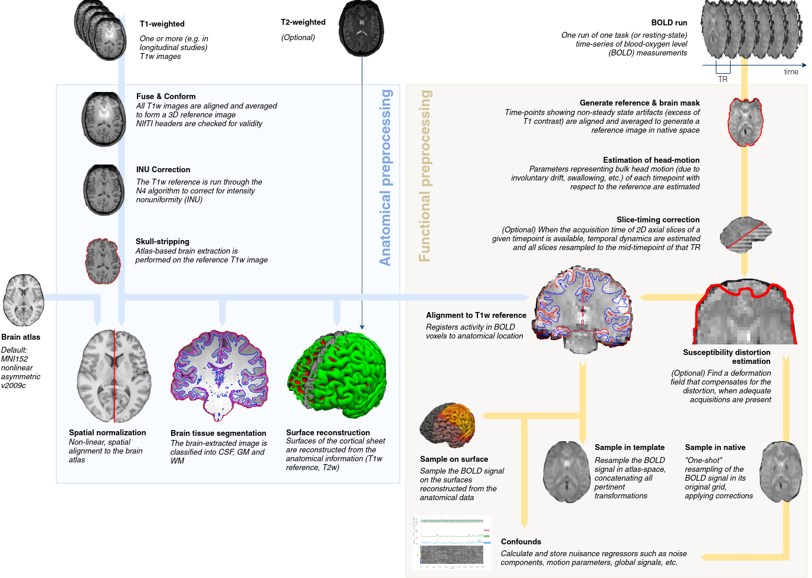
WTfMRIprep?
An attempt to demystify what fMRIprep is, does, and how
(with a discussion of BIDS).
Junaid Merchant | NACS Methods Seminar
April 24 2020
Notes:
As you might gather from the title slide, this will be fairly dry..
Also, I want you to take this seriously, so I used comic sans

Slide 2
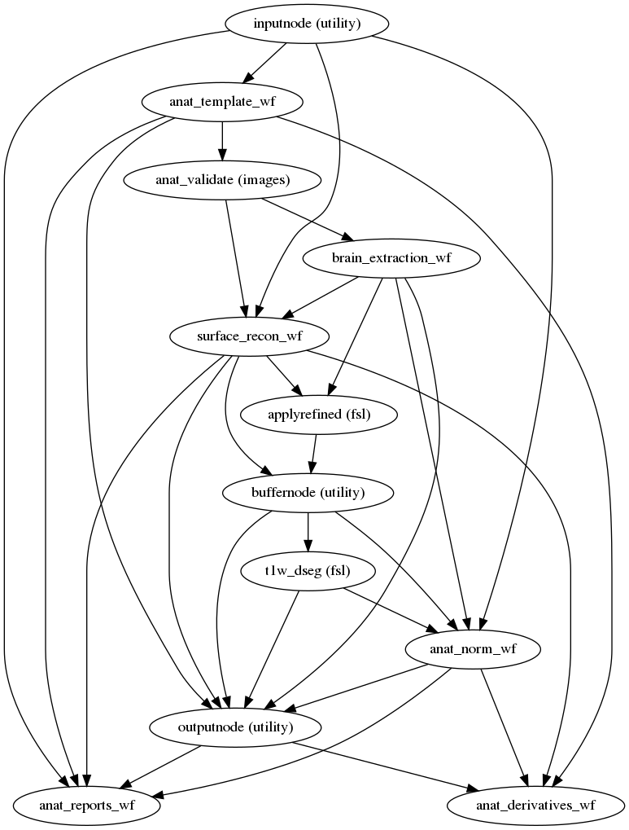
Outline
Brain Imaging Data Structure (BIDS)
What and why
Converting to BIDS
fMRIprep 1.4.1 (currently on 2.0+)
What
Why
How
Outputs & Post-Prep

Slide 3

BIDS: https://bids.neuroimaging.io/
Notes:
Simple might be an over-statement

Slide 4
BIDS: https://bids.neuroimaging.io/
About BIDS
“Neuroimaging experiments result in complicated data that can be arranged in many different ways. So far there is no consensus how to organize and share data obtained in neuroimaging experiments. Even two researchers working in the same lab can opt to arrange their data in a different way. Lack of consensus (or a standard) leads to misunderstandings and time wasted on rearranging data or rewriting scripts expecting certain structure. Here we describe a simple and easy to adopt way of organizing neuroimaging and behavioral data.”
Notes:
From the about page on BIDS website

Slide 5
BIDS: WHY (TF are you boring us with data organization)?
Standardization of how brain imaging data is (or should be) organized!
Reproducibility & replicability
Better documentation
Easy data sharing
OpenfMRI.org, OpenNeuro.org, & future of fMRI databases at NIH!)
Open science best practices
Machine readable = easier automation!
So many plug & play BIDS compatible apps (like fmriprep;)
Notes:
When joining a new lab, this might become very apparent. At GU, I worked a number of old data sets, and each one was organized differently-- was a nightmare.
-Reproducibility=can reproduce what one did with same data set;
-Replicability=eases attempts are replicating another
-Part of the BIDS standard is just having readme like documents at every directory level
-Makes it so easy to share data if everyone adopts the best standards.
--Check out OpenNeuro if you havent! Numerous freely available data sets to play with
-All of the above contributes to best practices for open science
-This standard makes it easy for software development! Especially the way that BIDS is designed, it makes it so that everything can be read-in, and processed with with minimal manual intervention (which we’ll see shortly with fMRIprep)
--Check out all the bids compatible apps!

Slide 6
BIDS Apps: http://bids-apps.neuroimaging.io/
Once you have your data organized in BIDS, there are a growing number of fMRI tools you can use in a “plug and play” manner:
pre-preprocessing
MRIQC – Automated quality checking fMRI data before preprocessing: https://mriqc.readthedocs.io/en/stable/
post-fMRIprep
SPM and AFNI analysis BIDS Apps
Advance analysis tools like MVPA, hyperalignment, connectomics etc.
Notes:
Here’s a barely readable list of the growing number of BIDS compatible apps available.

Slide 7
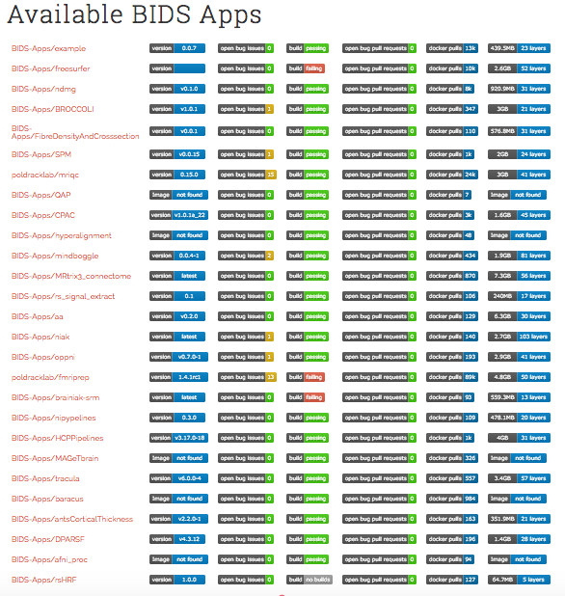
BIDS Apps: http://bids-apps.neuroimaging.io/
Notes:
Here’s a barely readable list of the growing number of BIDS compatible apps available.

Slide 8
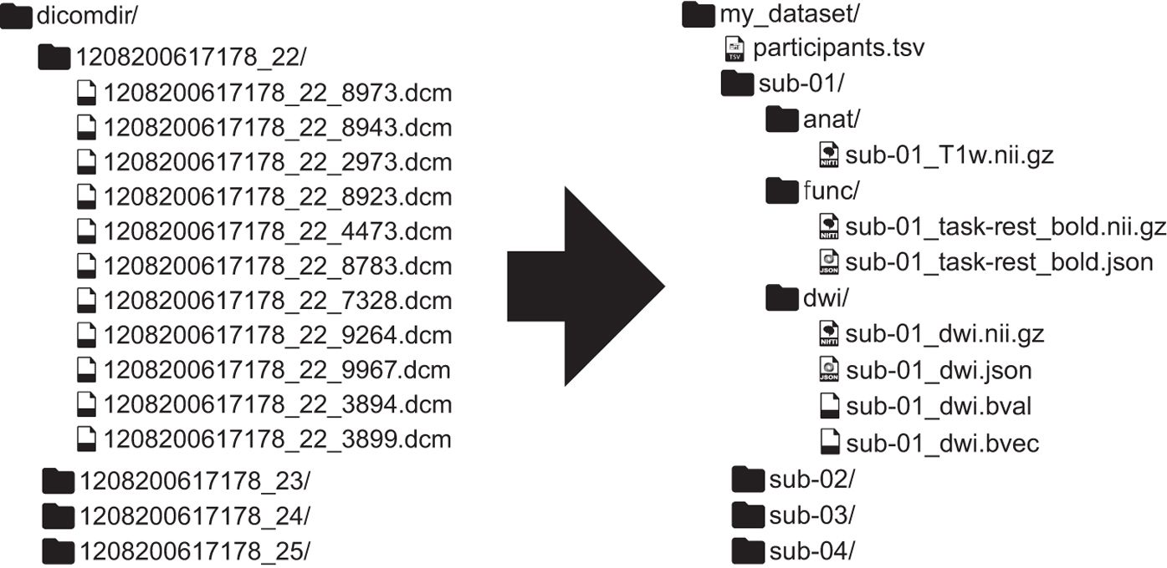
BIDS: What does it look like?
Notes:
This is one simplified example from the website

Slide 9
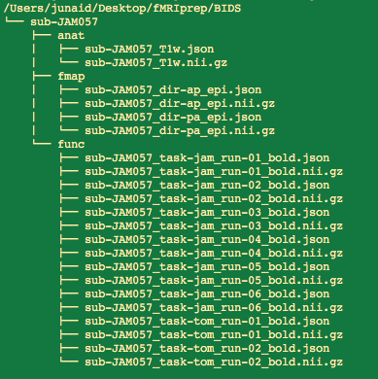
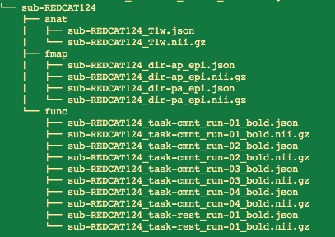
BIDS: What does our data look like?
Notes:
So, this is not exactly a fully BIDS compatible data-set. BIDS requires a couple more things:
A dataset_description.json file at the super-level directory
TaskName section in .json files for the jam .json files: You have to define 'TaskName' for this file. It can be included one of the following locations: /sub-JAM057/func/sub-JAM057_task-jam_bold.json, /sub-JAM057/sub-JAM057_task-jam_bold.json, /task-jam_bold.json, /sub-JAM057/func/sub-JAM057_task-jam_run-01_bold.json
Other things needed but not absolutely required:
.tsv files with the timing parameters for non-rest scans
And a README file at the super-level directory

Slide 10
BIDS: What does our’s look like?
So, this is not exactly a fully BIDS compatible data-set. BIDS requires a couple more things:
A dataset_description.json file at the super-level directory
TaskName section in .json files for the jam .json files: “You have to define 'TaskName' for this file. It can be included one of the following locations: /sub-JAM057/func/sub-JAM057_task-jam_bold.json, /sub-JAM057/sub-JAM057_task-jam_bold.json, /task-jam_bold.json, /sub-JAM057/func/sub-JAM057_task-jam_run-01_bold.json” (from BIDS validator)
Other things needed but not absolutely required:
.tsv files with the timing parameters for non-rest scans
And a README file at the super-level directory
BUT, this not-fully BIDS compatible data-set still works with fMRIprep!
Notes:
So, this is not exactly a fully BIDS compatible data-set. BIDS requires a couple more things:
A dataset_description.json file at the super-level directory
TaskName section in .json files for the jam .json files: You have to define 'TaskName' for this file. It can be included one of the following locations: /sub-JAM057/func/sub-JAM057_task-jam_bold.json, /sub-JAM057/sub-JAM057_task-jam_bold.json, /task-jam_bold.json, /sub-JAM057/func/sub-JAM057_task-jam_run-01_bold.json
Other things needed but not absolutely required:
.tsv files with the timing parameters for non-rest scans
And a README file at the super-level directory

Slide 11
Minimal BIDS requirements to work with fMRIprep:
Subject level directories labeled as such: sub-<subjectid>
<subjectid> cannot have dashes, spaces, underscores, or special characters
Within this directory, there are directories for each MR modality:
/anat - which contains all structural/anatomical scans
/func - all functional MRI scans including task and rest
/fmap - fieldmap scans. Can handle double-echo and opposite phase encoding scans. fMRIprep even has a fieldmapless distortion correction option!
/dwi - diffusion weighted scans if you have it i.e. DTI
There are other things they are expanding this to also--MEG, EEG etc
!! Each MRI file needs accompanying .json file (with same name) that has all info about the scan !!
All MRI files need to be in gzipped nifti format, that is .nii.gz, and 4D when applicable (i.e. functional runs)
Don’t freak out yet; most of this is handled by dicom conversion software/scripts!

Slide 12
BIDS naming conventions (focusing on our data):
All MRI file names start first with the sub-<subjectid>, followed by an underscore. E.g. sub-JAM057_ (the underscore & dash conventions make it machine readable).
anat: for our T1 MPRAGE structural, the scan files are simply T1w.nii.gz.
E.g. sub-JAM057_T1w.nii.gz
func: functional files are task-<taskname or rest>_run-<runnumber>_bold.nii.gz
E.g. sub-JAM057_task-jam_run-01_bold.nii.gz sub-REDCAT124_task-cmnt_run-01_bold.nii.gz & sub-REDCAT124_task-rest_run-01_bold.nii.gz
No dashes, underscores, spaces, or special characters in the task name
Run number is always two digits, if included (not necessary).
Other specifications for longitudinal data too but not covered here.
fmap: for the opposite phase-encoding direction fieldmaps (that we use), just follow the examples.
Not sure the minimal information required in the accompanying .json file for each, but conversion software provides all the scanning parameters and more!
Notes:
This is not a complete list. To know all the naming conventions, you must read the specifications paper, which is a better sleep aid than ambien.

Slide 13
BIDS Conversion: HeuDiConv
heuristic-centric DICOM converter (HeuDiConv) is the recommended way to convert from dicoms to BIDS
Organizes data, names files, and converts to formats to be BIDS compatible
uses the dcm2niix converter that generates the accompanying .json file you need for BIDS compatibility: https://github.com/rordenlab/dcm2niix
Full disclosure, I’ve not used it (wrote my own scripts) but it is highly recommended by the creators of BIDS/fMRIprep

Slide 14
BIDS Conversion using my dcm2niix wrapper
dcm2niix is dicom to nifti converter that provides the accompanying .json file you need for BIDS compatibility: https://github.com/rordenlab/dcm2niix
To match the BIDS naming convention & specifications, I created a pair of scripts that ‘wrap’ around the basic dcm2niix function.
BidsConvert.sh is the main script that takes the parameters file & subject ID as input, and does the conversion. It is designed to run locally or via SLURM
BidsConvertParameters.sh is the parameters file that you edit to fit the needs of your study.
Usage:
sbatch /path/to/BidsConvert.sh /path/to/BidsConvertParameters.sh <SubjectID>

Slide 15
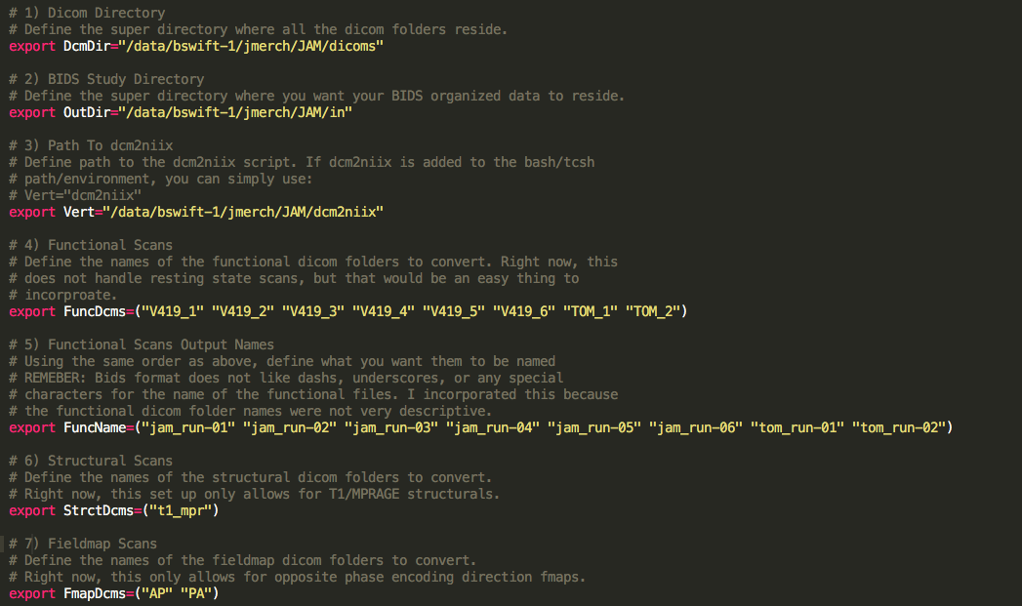
BIDS Conversion dcm2niix wrapper: Parameters file
Notes:
One of the few times I did a thorough job of commenting

Slide 16
BIDS Conversion dcm2niix wrapper: Parameters file
What you need to edit:
Path to dicom directory.
Path to directory where you want the converted files written.
Path to dcm2niix file (it’s a stand alone application but requires full path).
The names of the functional folders as they are in the dicom directory.
The names you want the functional files to have when converted, following the same order as the items item 4 above. Use BIDS specifications here!!
The name of the structural folder as it is in the dicom directory.
The names of the fieldmap folders as they are in the dicom directory.
There is one hacky thing in the main script to make fieldmaps work that needs work..
Notes:
All of these items are thoroughly documented in the parameter script.
The hacky thing I added was so that it would use the fieldmaps scans we collected to do fieldmap correction.

Slide 17
Notes:
One of the few times I did a thorough job of commenting

Slide 18
Final things to check out regarding BIDS
Learn from example by looking at these bids-examples: https://github.com/bids-standard/bids-examples/
Or check out the datasets at https://openneuro.org/
You can validate if your data structure is BIDS compatible: https://bids-standard.github.io/bids-validator/
But, as I said before, if you follow my examples, it will not pass full bids compatibility!
https://neurostars.org/ is an amazing forum where experts will answer any and all questions. Created by the fMRIprep/BIDS team

Slide 19
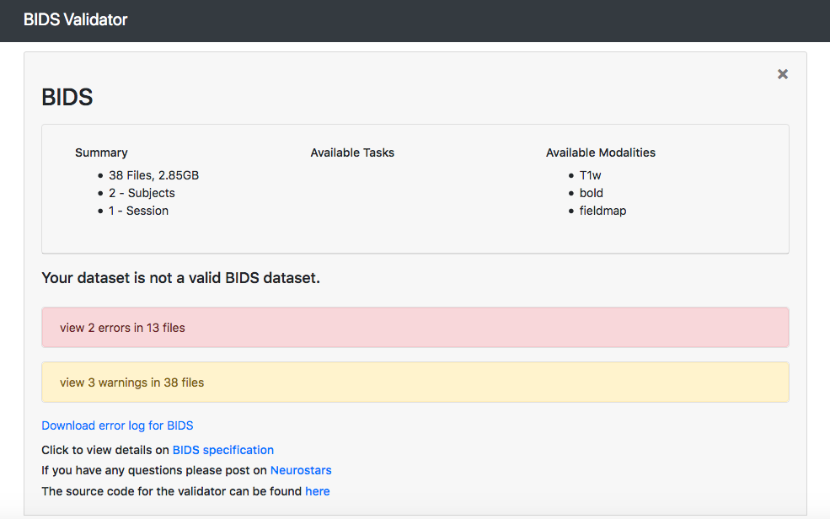
Final things to check out regarding BIDS
Learn from example by looking at these bids-examples: https://github.com/bids-standard/bids-examples/
Or check out the datasets at https://openneuro.org/
You can validate if your data structure is BIDS compatible: https://bids-standard.github.io/bids-validator/
But, as I said before, if you follow my examples, it will not pass full bids compatibility

Slide 20

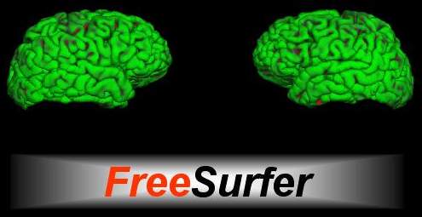
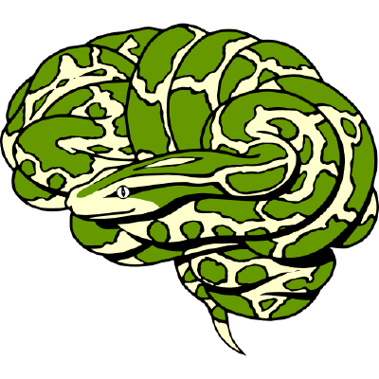
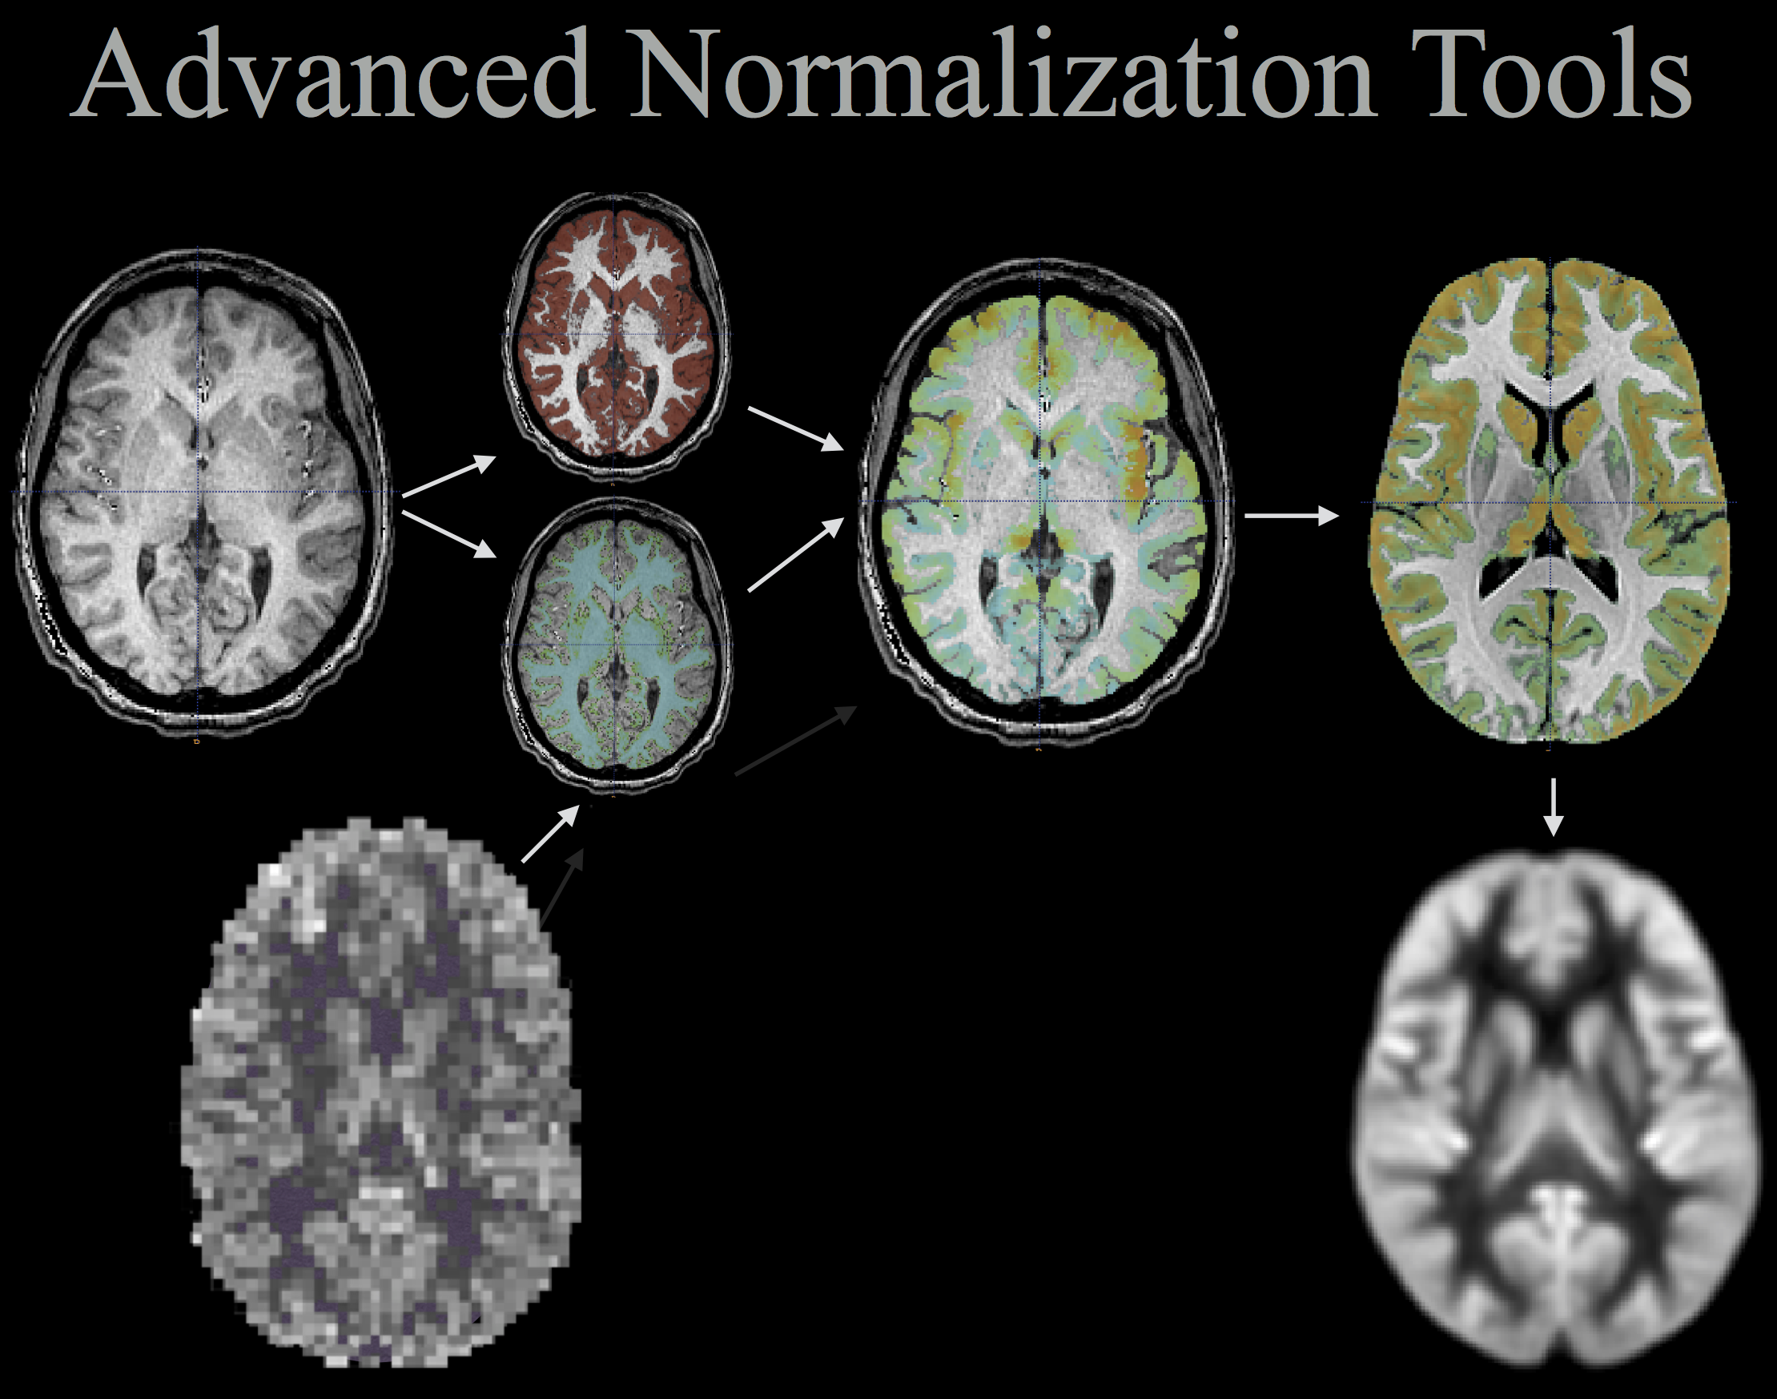

Time for fMRIprep: fmriprep.readthedocs.io/en/stable/
So, WTfMRIprep?!
fMRIprep is an advance fMRI preprocessing pipeline taking the best pieces from various different software packages, & pipes it together using NiPype python environment.

Slide 21
https://fmriprep.readthedocs.io/en/stable/
“fMRIprep is a functional magnetic resonance imaging (fMRI) data preprocessing pipeline that is designed to provide an easily accessible, state-of-the-art interface that is robust to variations in scan acquisition protocols and that requires minimal user input, while providing easily interpretable and comprehensive error and output reporting. It performs basic processing steps (coregistration, normalization, unwarping, noise component extraction, segmentation, skullstripping etc.) providing outputs that can be easily submitted to a variety of group level analyses, including task-based or resting-state fMRI, graph theory measures, surface or volume-based statistics, etc.”
Notes:
This is taken from the fmriprep website, here as reference

Slide 22
https://fmriprep.readthedocs.io/en/stable/
This tool allows you to easily do the following:
Take fMRI data from raw to fully preprocessed form.
Implement tools from different software packages.
Achieve optimal data processing quality by using the best tools available.
Generate preprocessing quality reports, with which the user can easily identify outliers.
Receive verbose output concerning the stage of preprocessing for each subject, including meaningful errors.
Automate and parallelize processing steps, which provides a significant speed-up from typical linear, manual processing.
Notes:
This is taken from the fmriprep website, here as reference

Slide 23

fMRIprep is simply the BEST prepackaged fMRI preprocessing pipeline available

Slide 24
fMRIprep pipeline
Notes:
Take time here to conceptually explain the preprocessing steps

Slide 25
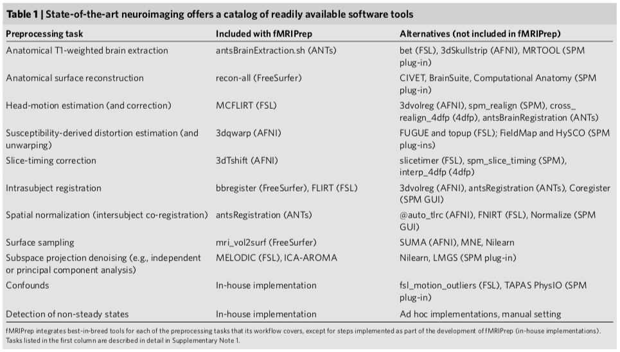

Slide 26
fMRIprep Installation: https://fmriprep.readthedocs.io/en/stable/installation.html
4 ways to install/use fMRIprep:
Openneuro.org - Free and easy to use, but requires full dataset that you might not want to share yet
Docker container - Easiest in my experience, but is not allowed on most servers because of security issues
http://reproducibility.stanford.edu/fmriprep-tutorial-running-the-docker-image/
Singularity container - Similar to Docker, but allowed on servers. A little harder to use (I’ll provide you one!)
Manually prepared environment - Not recommended
Notes:
We use Singularity container because that is what is allowed on neuron, brain, bswift

Slide 27
Quick note on Singularity and containerized environments
A containerized environment is like a virtual machine
You can shell into it like a server
You can gather everything required for fMRIprep in one packaged environment (single image file) that you can use on any computer/server
You can map data/folders between your local environment and the containerized environment
https://www.sylabs.io/guides/2.6/user-guide/
Notes:
“Containerization is a lightweight alternative to full machine virtualization that involves encapsulating an application in a container with its own operating environment. This provides many of the benefits of loading an application onto a virtual machine, as the application can be run on any suitable physical machine without any worries about dependencies.” https://www.webopedia.com/TERM/C/containerization.html

Slide 28
fMRIprep: Requirements (hardware)
fMRIprep is a computationally expensive that requires plenty of RAM, storage, and CPU power, and lots of time to run
Recommended to run on a:
Heavy duty desktop computer/workstation with plenty of RAM and storage
minimum RAM 8 GB, but recommended to have 16+
Few hundred GB of storage depending on what outputs you want
Lab dedicated server
High performance computing (HPC) clusters/supercomputers
Can be run on a powerful laptop, but you likely won’t be able to use the laptop for anything else while it is running.
If using a laptop, I recommend using the no-freesurfer option

Slide 29
fMRIprep: Requirements (software and data)
The minimal things you need:
At least one subject’s MRI data in BIDS format
Freesurfer license.txt file (if you want to run Freesurfer through fMRIprep). You can get one here: https://surfer.nmr.mgh.harvard.edu/fswiki/License
Software to run fMRIprep:
If you’re using your own workstation, I recommend implementing using Docker because it’s the easiest: https://fmriprep.readthedocs.io/en/stable/docker.html
Otherwise, I’ll be showing how to run fMRIprep through Singularity, which needs to be installed and can be run anywhere, including servers, workstation, etc
Here’s link to download a pre-made Singularity image for fMRIprep v1.4.1: https://drive.google.com/file/d/1R_SYNm6wrteJXK-xEyWMlfm-A1Qt77vv/view?usp=sharing

Slide 30
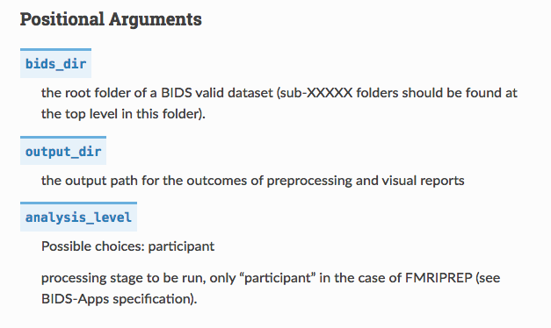
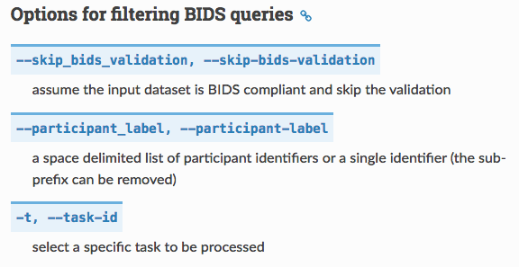
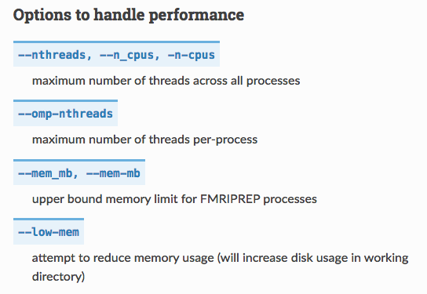
fMRIprep usage: https://fmriprep.readthedocs.io/en/stable/usage.html
Notes:
Focusing on the on just the options important for our purposes.
The positional arguments are required, and are the first options you give it, 1) including the input BIDS directory from which you want to ‘prep data, 2) output directory where you want ‘prepped data to be written, 3) analysis level which is only participant at this point
In the options for filtering, 1) I always include the skip-bids-validation because we meet the minimal requirements needed for fMRIprep to run, without being completely BIDS compliant. 2) You need to give the subject ID you want to run (using the BIDS label e.g. sub-JAM012), 3) Gives you the option of just running ‘prep on the specified task
The performance handling options are essential in for speeding up the process, but requires knowing what specs the machine/server/node you’re running on. I recommend maxing the specs without going over what the machine has, otherwise it’ll crash

Slide 31
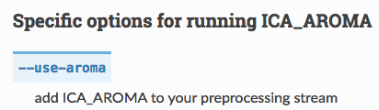
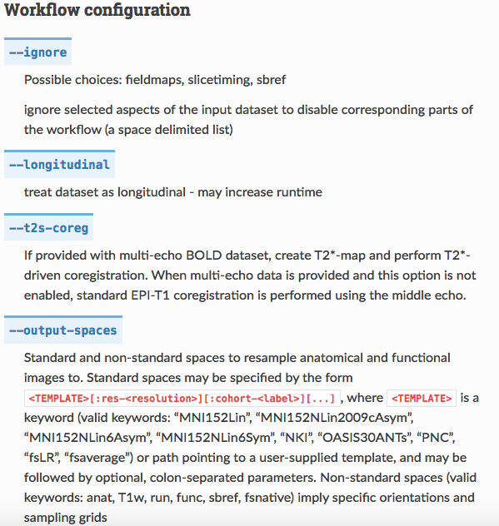
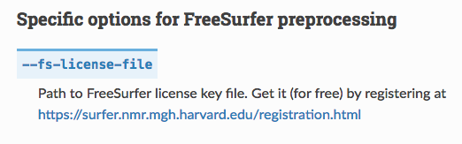
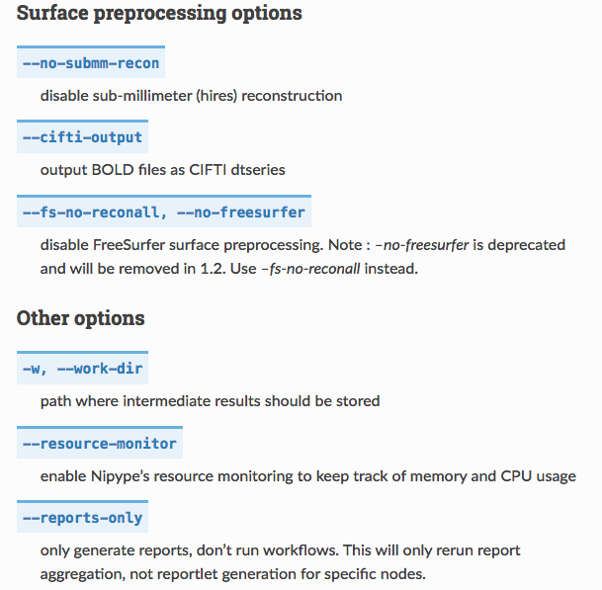
fMRIprep usage: https://fmriprep.readthedocs.io/en/stable/usage.html
Notes:
1)You can ignore/skip some of the steps like fmaping or slice time correction if you want 2) is an option for longitudinal datasets, 3) output spaces is where we’ll eventually be able to request pediatric templates. 4) use aroma includes the ICA-AROMA step which seems to be promising
5) no-submm-recon really speeds things up. This tells ‘prep to not do the super high resolution recon-all which it will default to on our data because our structurals are hires, sub mm resolution. 6) Cifti-output is the human connectome project format, which is an optimized file format that does the cortex in surface space and subcortex in volumetric space. I use this because i want to use the HCP workbenche later. 7) you can choose to completely not use freesurfer. 8) the work dir is where all intermediary files are saved, and uses up a TON of space.
9) The fs-license-file option is a hacky-ass fix they included to make freesurfer run. You have to specify the path to freesurfer license so that it’ll run. It’s the wierdest required option.

Slide 32
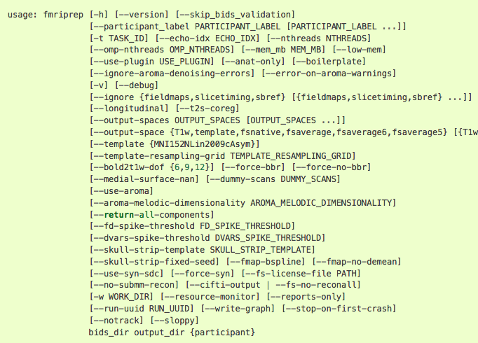
fMRIprep usage: https://fmriprep.readthedocs.io/en/stable/usage.html
Notes:
These are all the options!

Slide 33
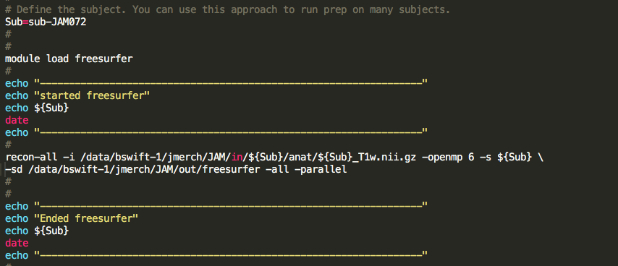
Our fMRIprep usage via Singularity (when it gets a little tricky)
One major change that I’ve added that considerably speeds up processing is to run Freesurfer using the –parallel option prior to fmriprep:
Notes:
If you run freesurfer using the parallel option as it is here. This is all in the example script for you to modify and use as needed.

Slide 34
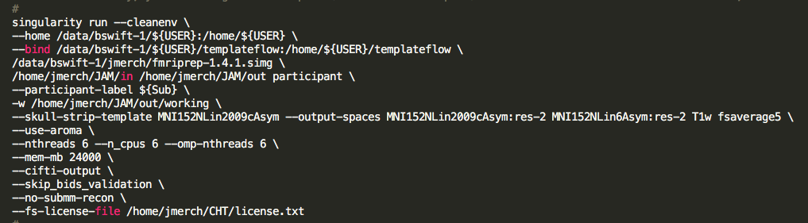
Our fMRIprep usage via Singularity (when it gets a little tricky)
Notes:
The slashes at the end of each line is telling it to continue the line on the next.

Slide 35
Our fMRIprep usage via Singularity (when it gets a little tricky)
Run a singularity container with a clean environment.
Notes:
The slashes at the end of each line is telling it to continue the line on the next.

Slide 36
Our fMRIprep usage via Singularity (when it gets a little tricky)
Bind the local directory that you’re working from to the /home directory inside the container. This can get very tricky, so I recommend having everything you need for fMRIprep in one directory on your local environment because singularity wants to run everything from “home” directory. Everything on the left side of the colon will be given the new path indicated on the right side of the colon inside the container.
Notes:
This part is what took me the longes

Slide 37
Our fMRIprep usage via Singularity (when it gets a little tricky)
This is the last time you will use your local path, and it is to indicate where the fmriprep singularity image is. These singularity images usually have .simg or .sif
Notes:
This part is what took me the longes

Slide 38
Our fMRIprep usage via Singularity (when it gets a little tricky)
The positional arguments required. Input BIDS directory, output directory where you want ‘prepped data written, and analysis level is participant. NOTE that the paths are the new paths from inside the container!
Notes:
The slashes at the end of each line is telling it to continue the line on the next.

Slide 39
Our fMRIprep usage via Singularity (when it gets a little tricky)
The participant you want to ‘prep. Here it is designated as a bash variable, but you can simply use the sub ID (in the BIDS folder)
Notes:
The slashes at the end of each line is telling it to continue the line on the next.

Slide 40
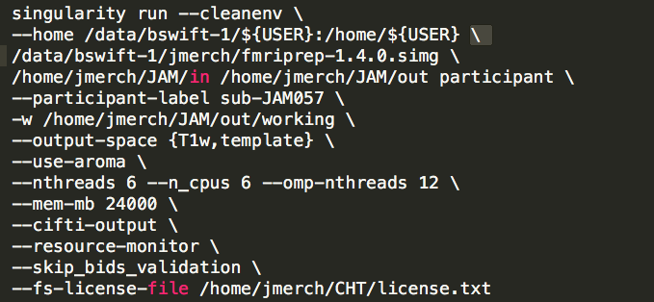
Our fMRIprep usage via Singularity (when it gets a little tricky)
Working directory where you want intermediate files saved. This directory takes up tons of storage, so I recommend deleting the folder after you’ve run ‘Prep, and QCed the output
Notes:
The working directory ends up taking up a lot of storage space, so I recommend deleting it after you have finished prepping and quality checked the out put.

Slide 41
Our fMRIprep usage via Singularity (when it gets a little tricky)
Starting with v1.4.1, you can choose what templates you want the output data normalized to. For the skull strip template, I recommend sticking with MNI152NLin2009cAsym, but you can choose from a number of spaces for normalization (including pediatric templates!). Here I’m having it output to the MNILin2009 template in 2mm resolution and the newer MNI template. Also, T1w indicates that I also want it in native space, and fsaverage5 means to the freesurfer mesh. Full list of templates: https://github.com/templateflow/templateflow
Notes:
The slashes at the end of each line is telling it to continue the line on the next.

Slide 42
Our fMRIprep usage via Singularity (when it gets a little tricky)
Use AROMA (optional). I highly recommend this for univariate analysis. Briefly, automatic removal of motion artifact (AROMA) is an ICA paired with machine learning approach to removing motion effects, and gives you really boosted, gorgeous univariate results. Using this precludes the need to include motion regressors at the modeling stage. This approach involves a smoothing step, so is not recommended for pattern based analyses.
Notes:
The slashes at the end of each line is telling it to continue the line on the next.

Slide 43
Our fMRIprep usage via Singularity (when it gets a little tricky)
Hardware specifications based on the hardware available on the machine you are running this on. If you allocate more specs than is available, the program will crash.
Notes:
The slashes at the end of each line is telling it to continue the line on the next.

Slide 44
Our fMRIprep usage via Singularity (when it gets a little tricky)
Cifti output is the human connectome project file format, and great for surface based analyses. I skip bids validation because I don’t have the timing files there. Finally, no-submm-recon is recommended to speed up processing. Even freesurfer recommends against it if your T1 is higher resolution than .75 mm
Notes:
The slashes at the end of each line is telling it to continue the line on the next.

Slide 45
Our fMRIprep usage via Singularity (when it gets a little tricky)
This is the last where you need to specify the path to the freesurfer license using the within container path. You can download a FS license for free from their website.
Notes:
The slashes at the end of each line is telling it to continue the line on the next.

Slide 46
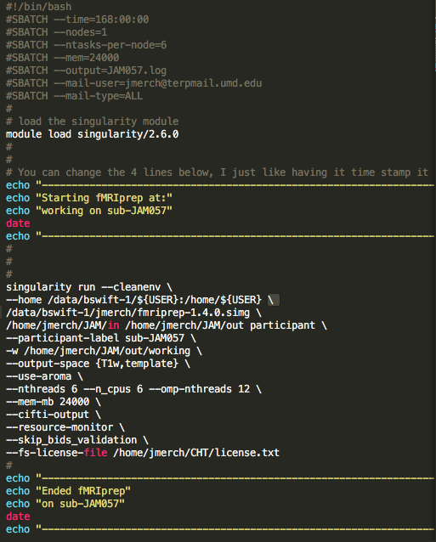
Putting it all together for a SLURM batch script
You can reference the SLURM presentation in the shared google folder for more detailed explanation of the slurm options.

Slide 47
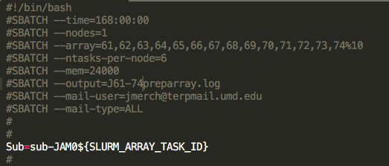
Putting it all together for a SLURM batch script
Quick note on array jobs: instead of running each subject one at a time, you can set up an array job by adding in one more parameter
In the array parameter, you can list the subject ID numbers you want to run separated by commas. The %10 at the end means run 10 at once (which is the max we’re supposed to run).
Notes:
This will make it so that you don’t have to manually monitor this, and can simply enter all the subject IDs and let it run till it’s finished. In the listing subject ID numbers though, leading zeros will be omitted.

Slide 48
Putting it all together for a SLURM batch script
Quick note on array jobs: instead of running each subject one at a time, you can set up an array job by adding in one more parameter
The only big difference here (compared to the example script), is how assign the subject identifier.

Slide 49
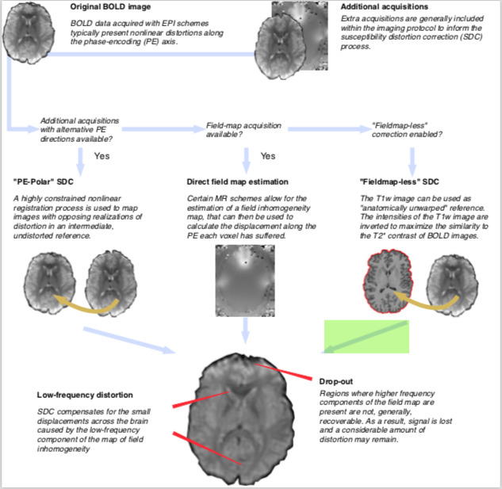
Note on fieldmaps
fMRIprep can do fieldmap correction in a few different ways.
If you have the traditional double-echo fieldmaps
If you have the opposite phase encoding direction fieldmaps
And a a fieldmap-less distortion correction.
Notes:
I

Slide 50
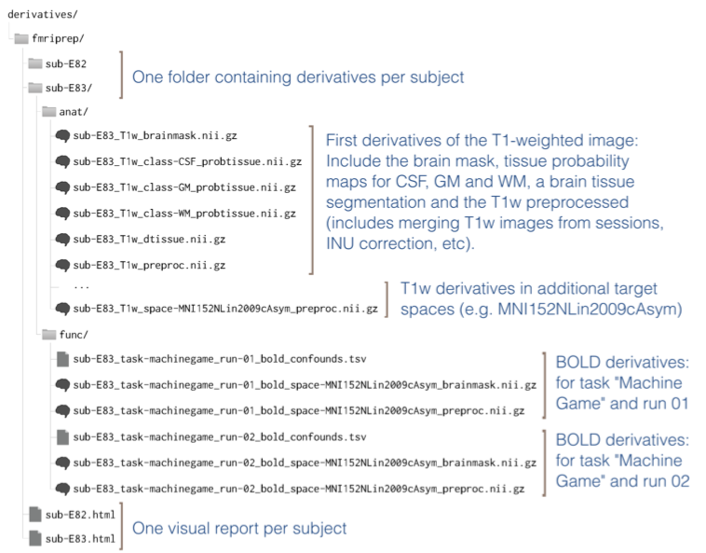
fMRIprep outputs: Folder
Notes:
Very similar to the BIDS organization, fmriprep output creates a folder of preprocessed data (derivatives).

Slide 51
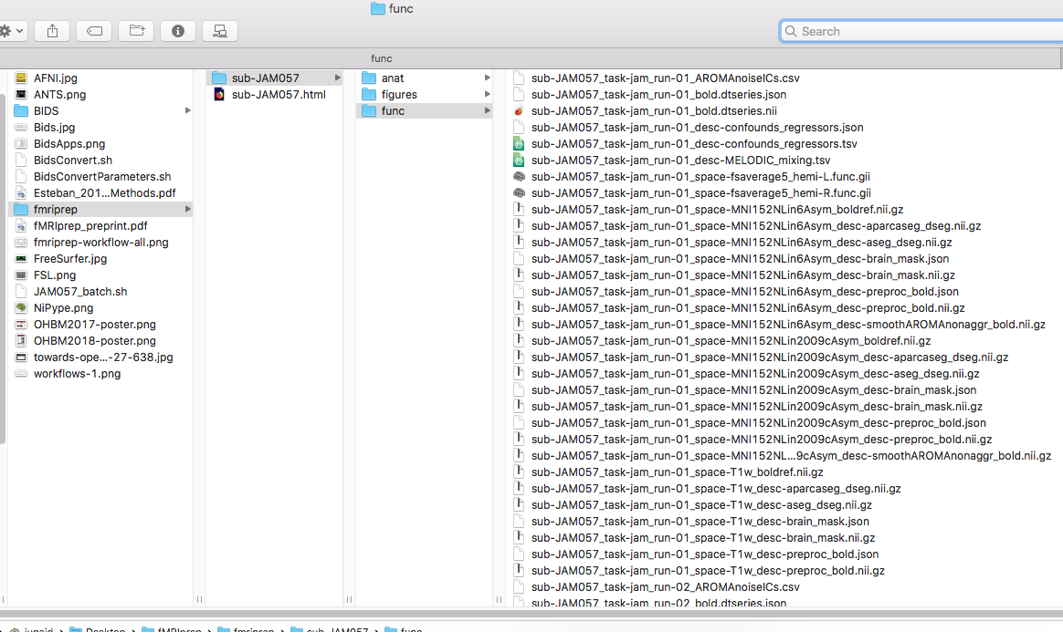
fMRIprep outputs: Folder
Notes:
Very similar to the BIDS organization, fmriprep output creates a folder of preprocessed data (derivatives).

Slide 52
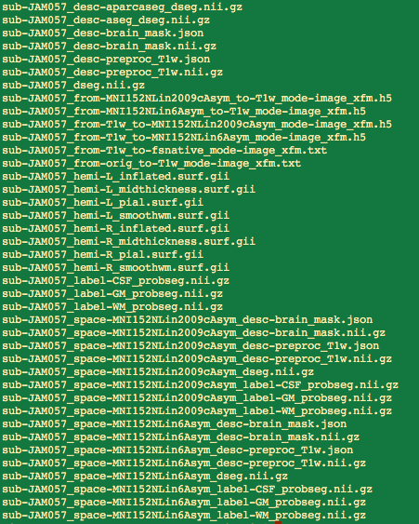
Naming conventions (similar to BIDS):
All file names start first with the sub-<subjectid>, followed by an underscore. E.g. sub-JAM057_
anat/:
‘desc’ indicates native space
‘preproc’ indicates preprocessed (INU in this case)
‘from’ files are text files with warping parameters to different spaces
.gii files are freesurfer things
‘space-’ files indicate what space they’re in
sub-JAM057_space-MNI152NLin2009cAsym_desc-preproc_T1w.nii.gz is normalized structural to the MNI152NLin2009 Asymetric space.

Slide 53
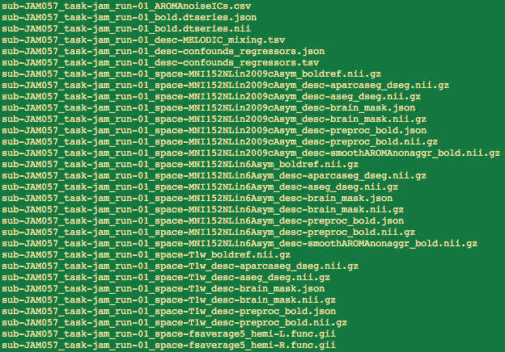
Naming conventions (similar to BIDS):
func/:
AROMAnoiseICs is a csv of the components
dtseries is cifti output
MELODIC is melodic ICA output (?) & the confounds regressor is massive list of potential regressors you can use for first level, like motion, FD, CompCor, and much more!
_boldref.nii.gz is reference single image
space-<template>_desc-preproc_bold.nii.gz are the files that are fully preprocessed in the space listed in the template position 4d file
smoothAROMAnonaggr is the AROMA denoised image
_space-T1w is native space

Slide 54
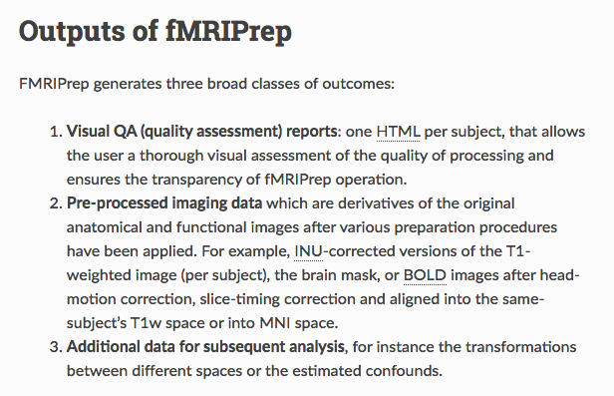
Full documentation on Outputs: https://fmriprep.readthedocs.io/en/stable/outputs.html

Slide 55
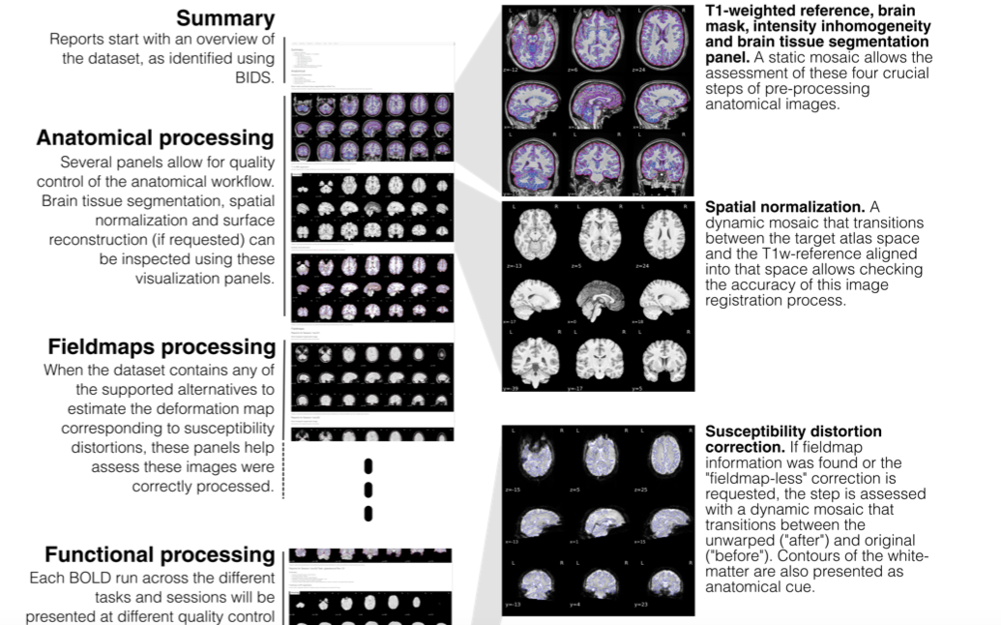
fMRIprep outputs: Report
Notes:
These are taken from the preprint

Slide 56
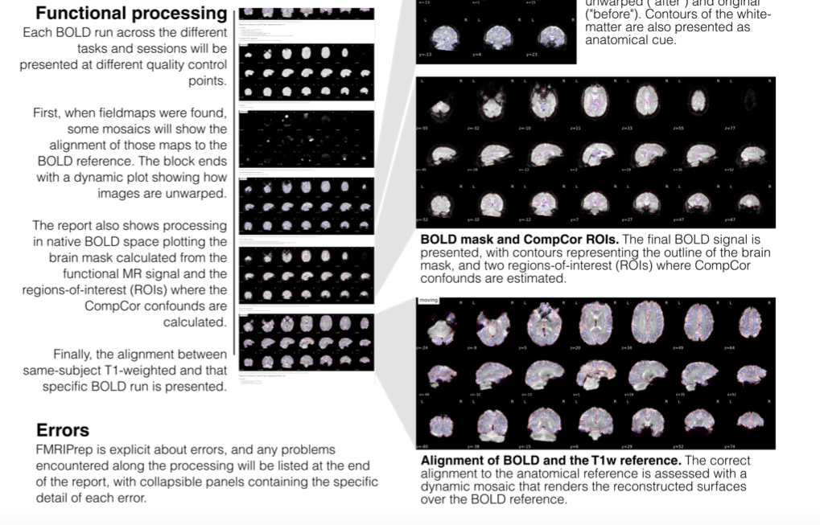
fMRIprep outputs: Report
Notes:
Very similar to the BIDS organization, fmriprep output creates a folder of preprocessed data (derivatives).

Slide 57
Other useful resources:
I can’t emphasize enough how awesome neurostars.org is!
Some good materials on a lot of these tools: https://bircibrain.github.io/computingguide/docs/fmri-preprocessing/fmriprep.html
heudiconv: http://reproducibility.stanford.edu/bids-tutorial-series-part-2a/
https://rpubs.com/sarenseeley/bids-fmriprep-mriqc
http://reproducibility.stanford.edu/fmriprep-tutorial-running-the-docker-image/
https://dartbrains.org/features/notebooks/8_fmriprep_tutorial.html
https://miykael.github.io/nipype_tutorial/notebooks/introduction_dataset.html
https://neurostars.org/t/convert-data-to-bids-format/720

Slide 58
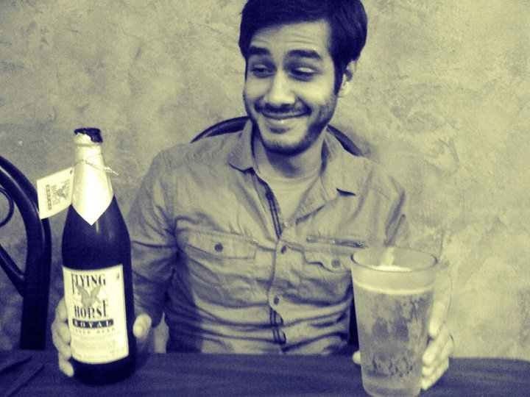
Questions?
I’m available for consulting on how to get you set up on an HPC for the price of some beer and/or food (or cash)!
#AlwaysLookingForASideHustle
merchantjs@gmail.com
828-301-3155

